Slide 1

Hacktoberfest 101
Saad Irfan
Software Engineer @ Kyte
@msaaddev

Slide 2



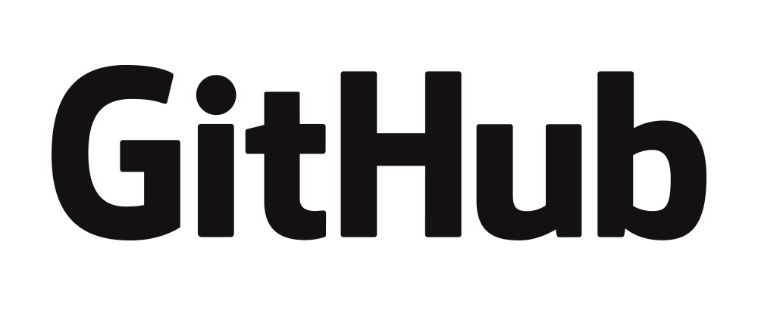


A few things about me
Software Engineer @ Kyte Systems Inc
Previously @ RapidAPI (World’s largest API Hub)
Open-source maintainer (Created 20+ tools)
Technical Writer (Authored 200+ tech guides)
Next.js Conf Speaker (2021)
Major League Hacking Intern
Former Microsoft Learn Student Ambassador
Founder of Google Developer Students Club UET Chapter
Former Web Development team lead @ ACM UET
UET Alum (Class of 2022)

Slide 3
How many of you are already familiar with Hacktoberfest?

Slide 4
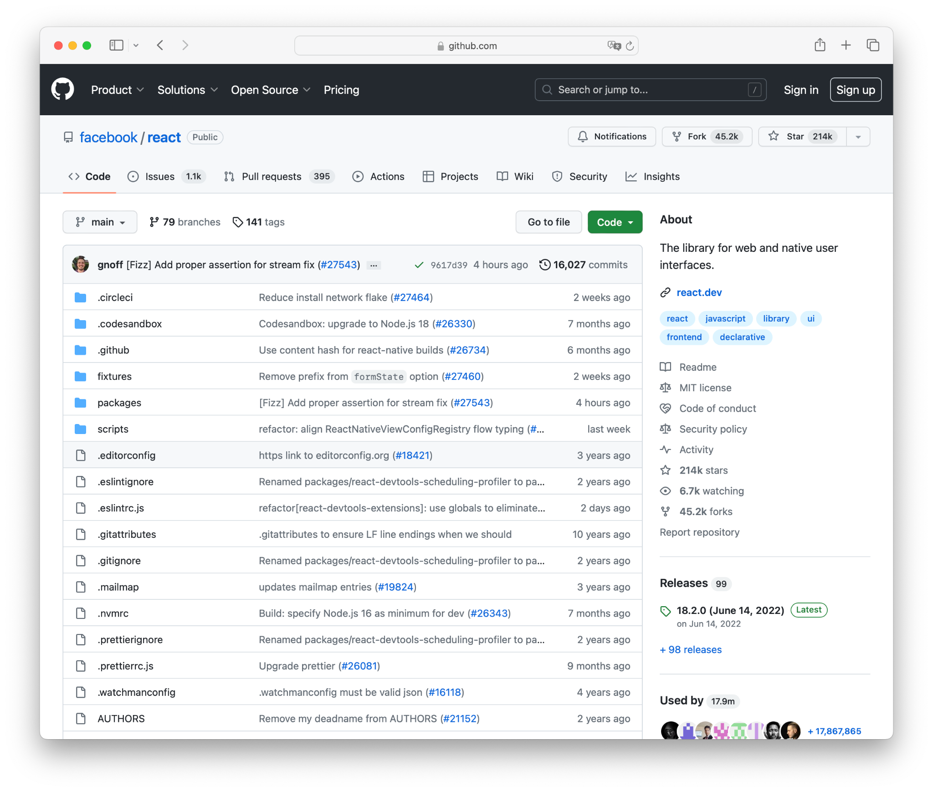
Open-source
Solutions to problems
Publicly Accessible Source Code
Collaborative Development
Transparency and Security
Cost-Free or Low-Cost
Code contributor
Project author
E.g., NPM packages
Notes:
Publicly Accessible Source Code: Open-source software provides unrestricted access to its source code, which is the human-readable instructions that make up the software. This code is typically hosted on platforms like GitHub, making it available to anyone.
Permission to Use, Modify, and Distribute: Open-source licenses grant users the freedom to use the software for any purpose, modify it to suit their needs, and redistribute it to others. This promotes flexibility and adaptation.
Collaborative Development: Open-source projects often involve a community of developers who work together to enhance the software. These contributors can be from diverse backgrounds and organizations.
Transparency and Security: With open source, the code is open to public scrutiny, which can enhance software security. Vulnerabilities and issues can be discovered and fixed more quickly because of the collective efforts of the community.
Cost-Free or Low-Cost: Open-source software is typically available at no cost. This can lead to significant cost savings for individuals and organizations compared to proprietary software.

Slide 5
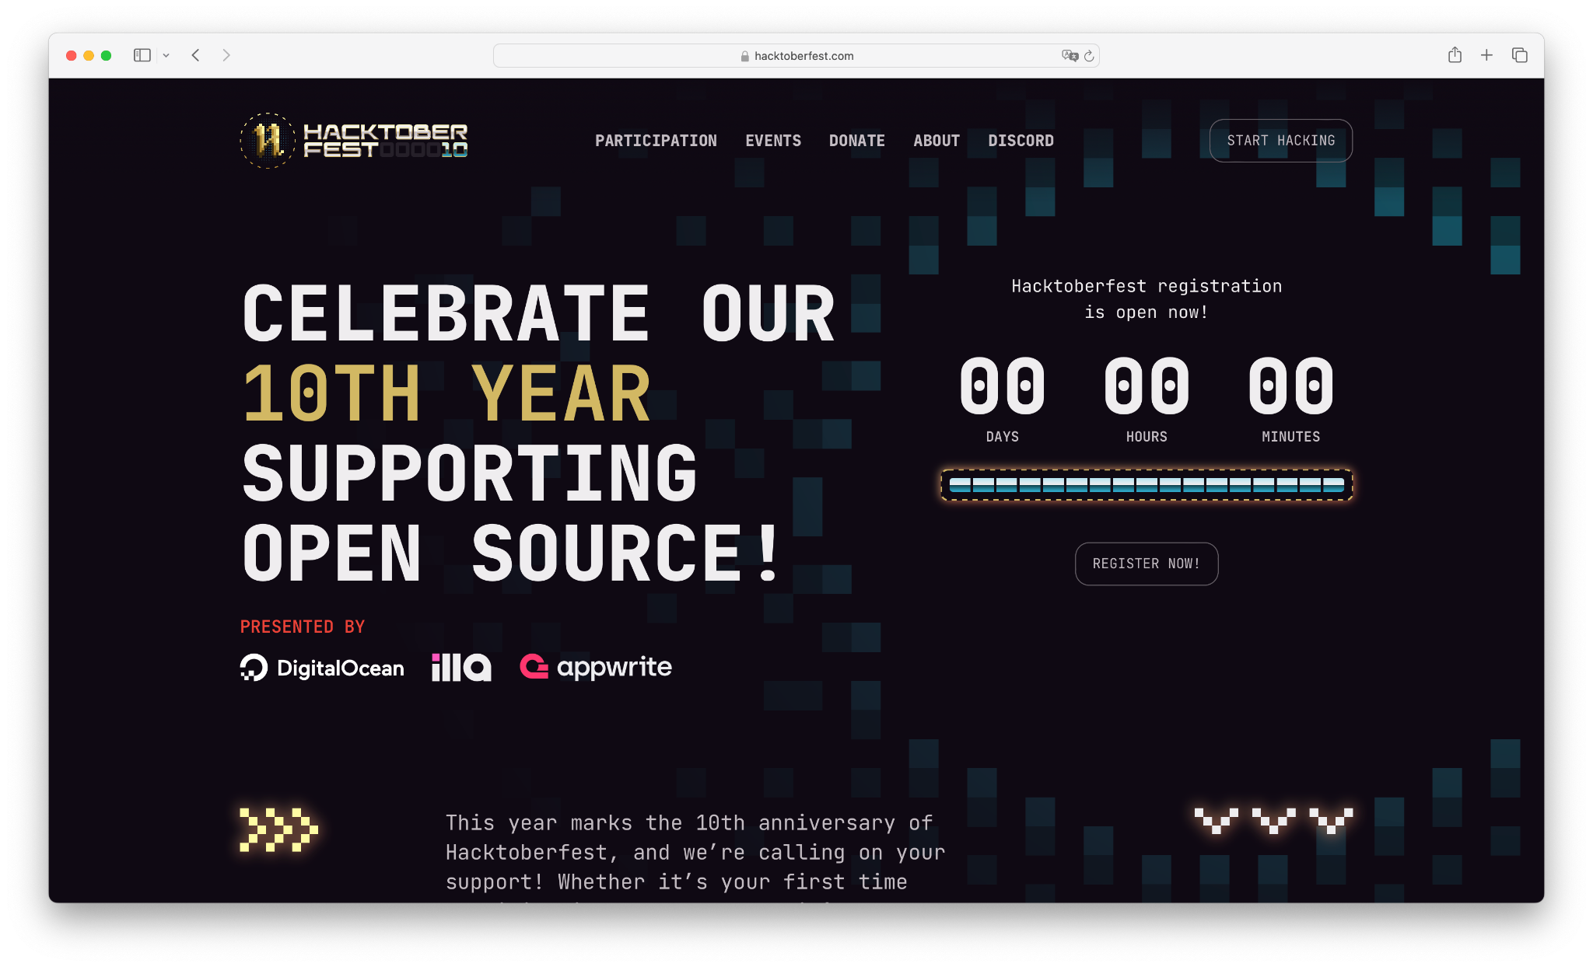
Hacktoberfest
Aims to promote and support the open-source community.
Make contributions to open-source projects by submitting pull requests.
Welcomes developers of all skill levels.
Fosters a sense of community among open-source enthusiasts.
Notes:
Open Source Celebration: Hacktoberfest is a month-long celebration of open-source software, held every October. It aims to promote and support the open-source community.
Participation and Contribution: Participants are encouraged to make meaningful contributions to open-source projects by submitting pull requests (PRs) on platforms like GitHub. These contributions can include code, documentation, bug fixes, or any valuable improvements.
Inclusivity: Hacktoberfest welcomes developers of all skill levels. It's not just for experienced programmers, but also for newcomers who want to start contributing to open source.
Quality Over Quantity: In the past, there were issues with spammy and low-quality contributions. To address this, Hacktoberfest introduced more stringent rules, encouraging contributors to focus on quality contributions rather than quantity. This includes a minimum of four meaningful PRs and a review process.
Community Building: Hacktoberfest fosters a sense of community among open-source enthusiasts. It's a great opportunity to learn, collaborate, and give back to the projects that power the software world.

Slide 6
How to participate
Register on Hacktoberfest website using GitHub / GitLab account
Find repositories that accept Hacktoberfest contributions (hacktoberfest label)
Submit four pull requests
Make sure to have hacktoberfest label in your PR
→ You can also follow the steps listed here
Notes:
Find small issues
Fix docs and submit PRs

Slide 7
Benefits
Coding Skill development
Portfolio Enhancement
Personal & Professional Growth
Exposure to Diverse Technologies
Learning from Others
Networking Opportunities
Notes:
Skill Development:
Coding Skills: Hacktoberfest motivates you to work on real-world coding projects. You can improve your coding skills by tackling issues and making contributions to various open-source projects.
Version Control: You'll become more proficient with version control systems like Git, an essential skill for developers.
Collaboration: Open source projects often involve teamwork. You'll learn how to collaborate with others, discuss technical topics, and work in a distributed development environment.
Portfolio Enhancement: By actively participating in Hacktoberfest, you'll accumulate a track record of open-source contributions, which can be a valuable addition to your portfolio, demonstrating your commitment to the community and your technical abilities.
Personal & Professional Growth:
You'll encounter a variety of coding challenges, helping you grow as a problem solver.
Companies often value open-source contributions. Listing Hacktoberfest contributions on your resume can make you a more attractive candidate.
Exposure to Diverse Technologies: You can work on a wide range of open-source projects, exposing yourself to diverse technologies and programming languages. This broadens your knowledge and skills.
Learning from Others: Reviewing others' code and having your code reviewed is an excellent way to learn from experienced developers. You'll receive feedback that can help you grow.
Networking Opportunities:
Connect with Peers: You'll meet like-minded individuals who share your passion for technology and open source. This can lead to lasting friendships and collaborations.
Mentorship: Interacting with experienced open-source contributors can provide valuable mentorship opportunities, helping you grow as a developer.
Visibility: Your contributions will be visible to a global audience, potentially leading to new career opportunities and recognition within the developer community.

Slide 8


Let’s have some question

